Slide 1
Structured data
Visit https://bit.ly/ds-dojo-2024 for materials
Pandas, CSVs, Excel and APIs

Slide 2
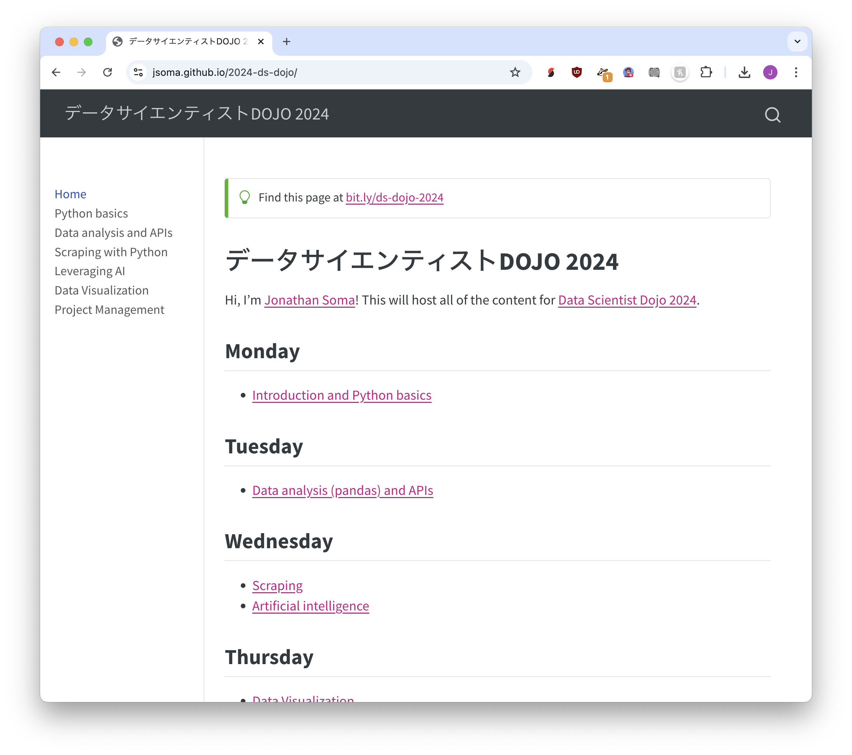
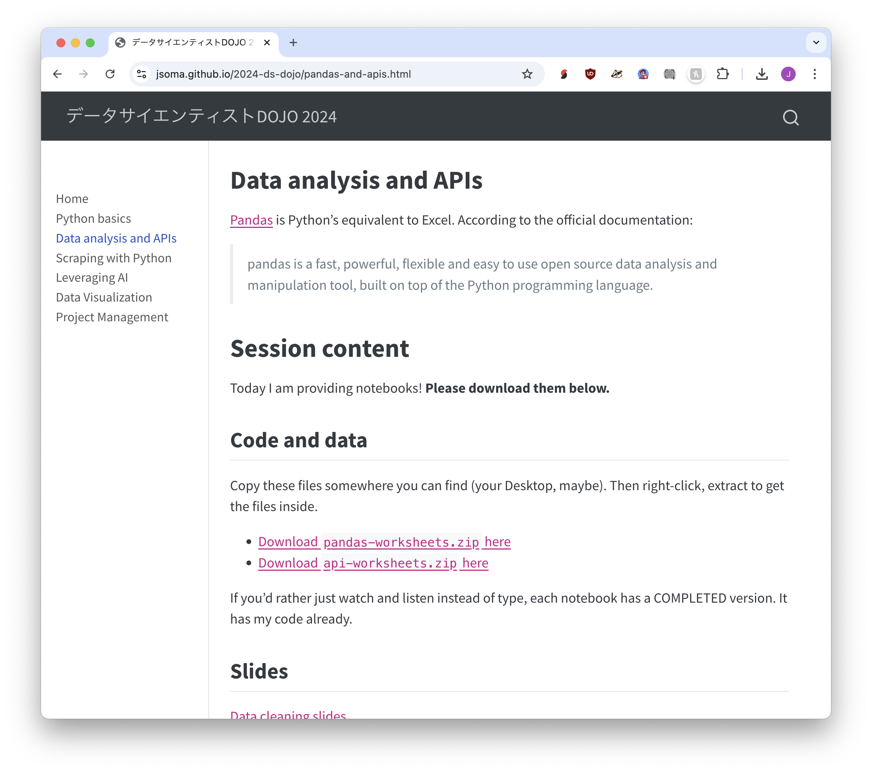


Visit https://bit.ly/ds-dojo-2024 for materials
① Click “Data analysis and APIs”
② Download today’s content
③ Right-click, extract to open it

Slide 3
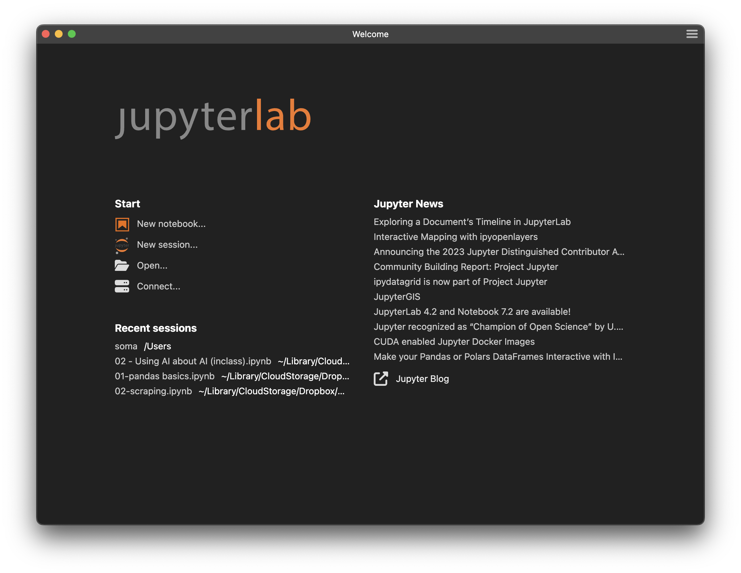
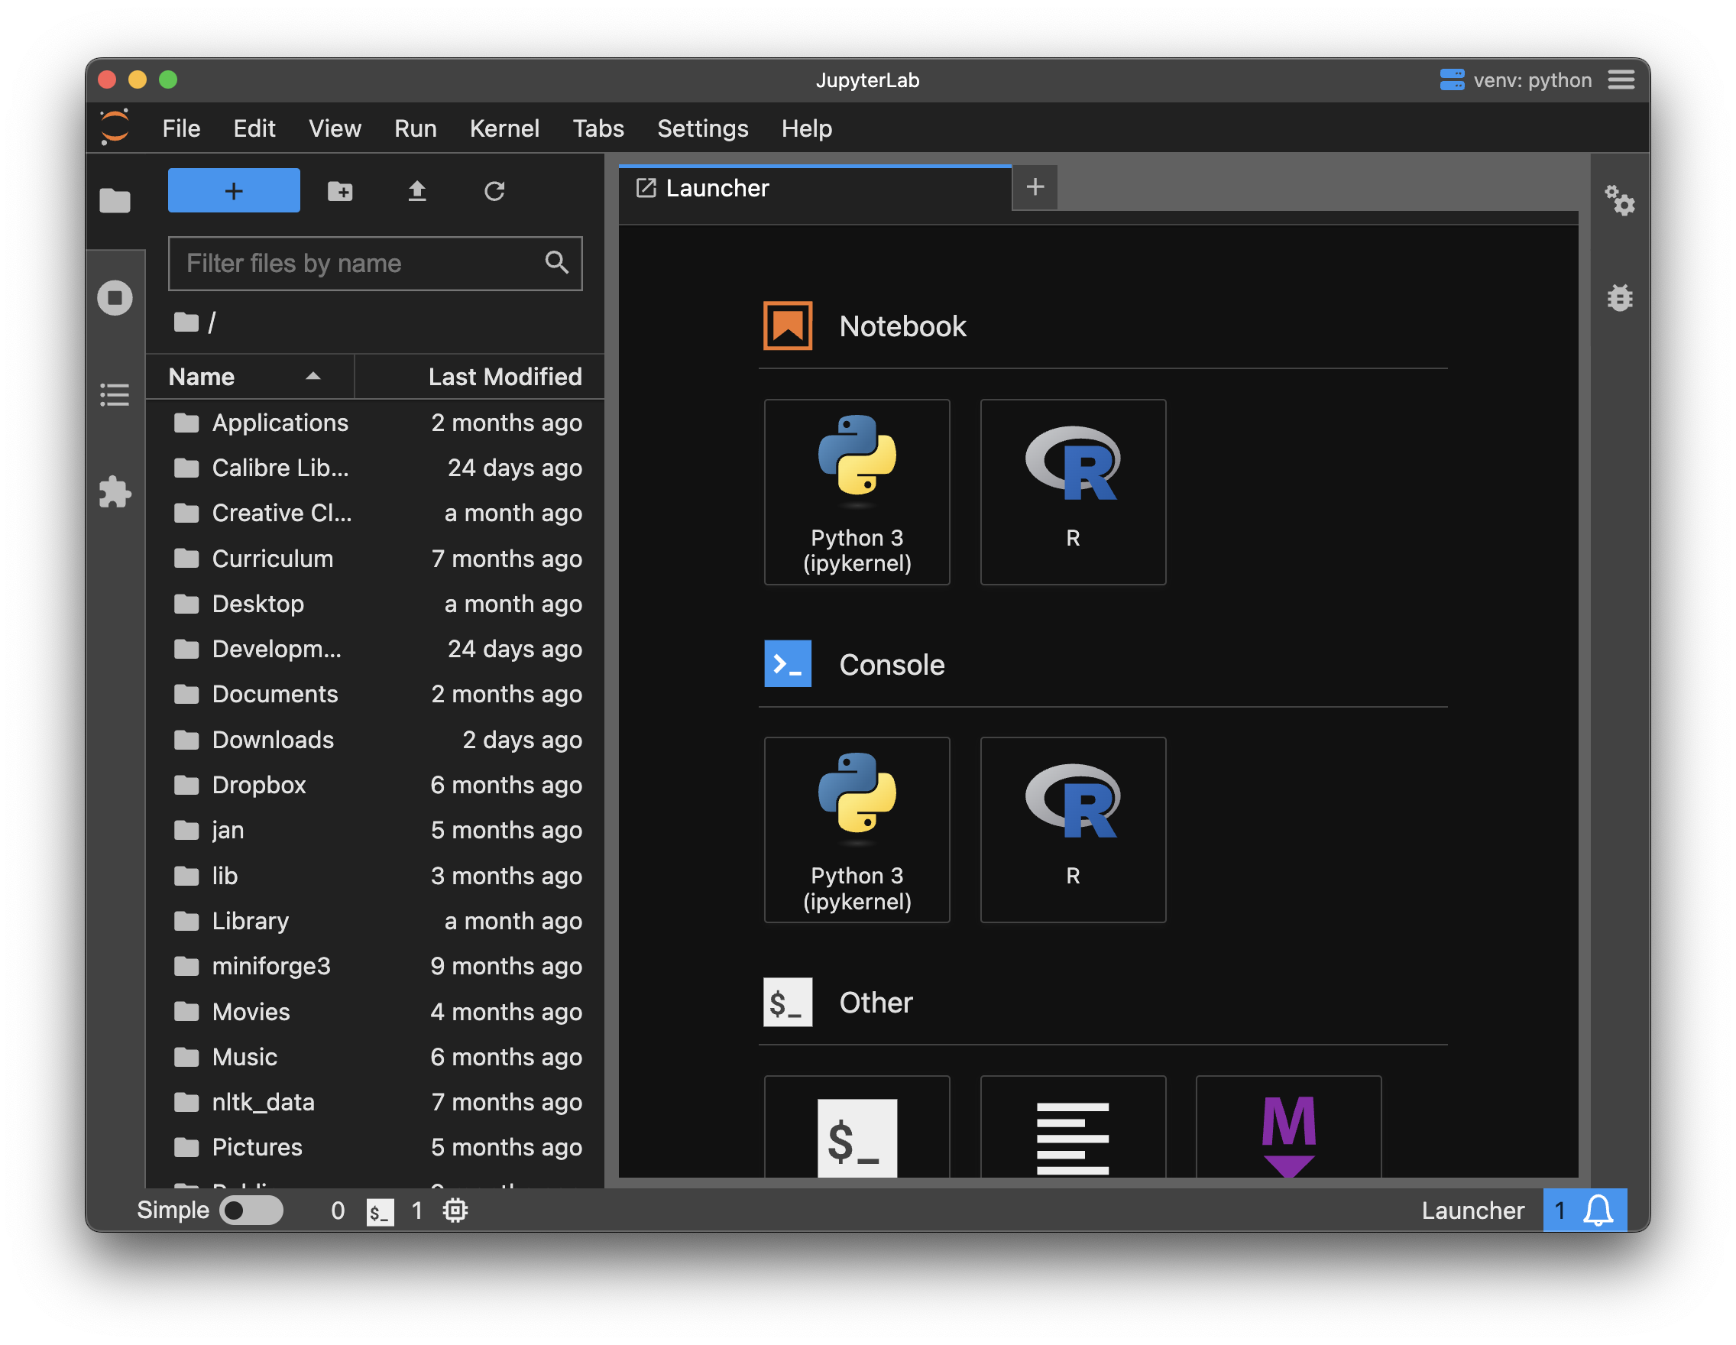




Open 01-pandas basics.ipynb
Visit https://bit.ly/ds-dojo-2024 for materials
② Browse
① Click “New session”
③ Click 01-pandas basics.ipynb

Slide 4
Now let’s do a little pandas

Slide 5
Basic concepts
Basic data cleaning
replace and split are 99% of the game

Slide 6


66 years old
replace “ years old”
with… nothing!
66 years old
convert to number
66

Slide 7


j soma, js4571@columbia.edu, @dangerscarf
split on “, “
j soma js4571@columbia.edu @dangerscarf
take second piece
js4571@columbia.edu

Slide 8





j soma, js4571@columbia.edu, @dangerscarf
split
j soma js4571@columbia.edu @dangerscarf
take second
js4571@columbia.edu
split on @
replace with nothing
js4571 columbia.edu
js4571@columbia.edu
take second
columbia.edu

Slide 9
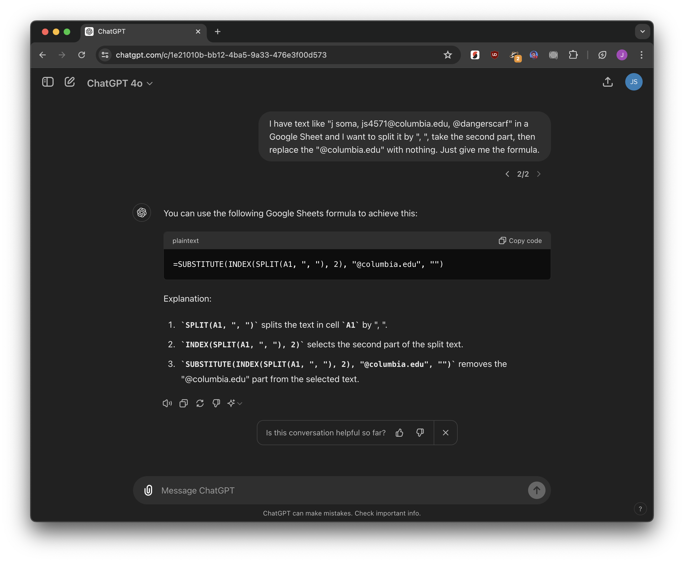
just ask!
then TEST IT

Slide 10
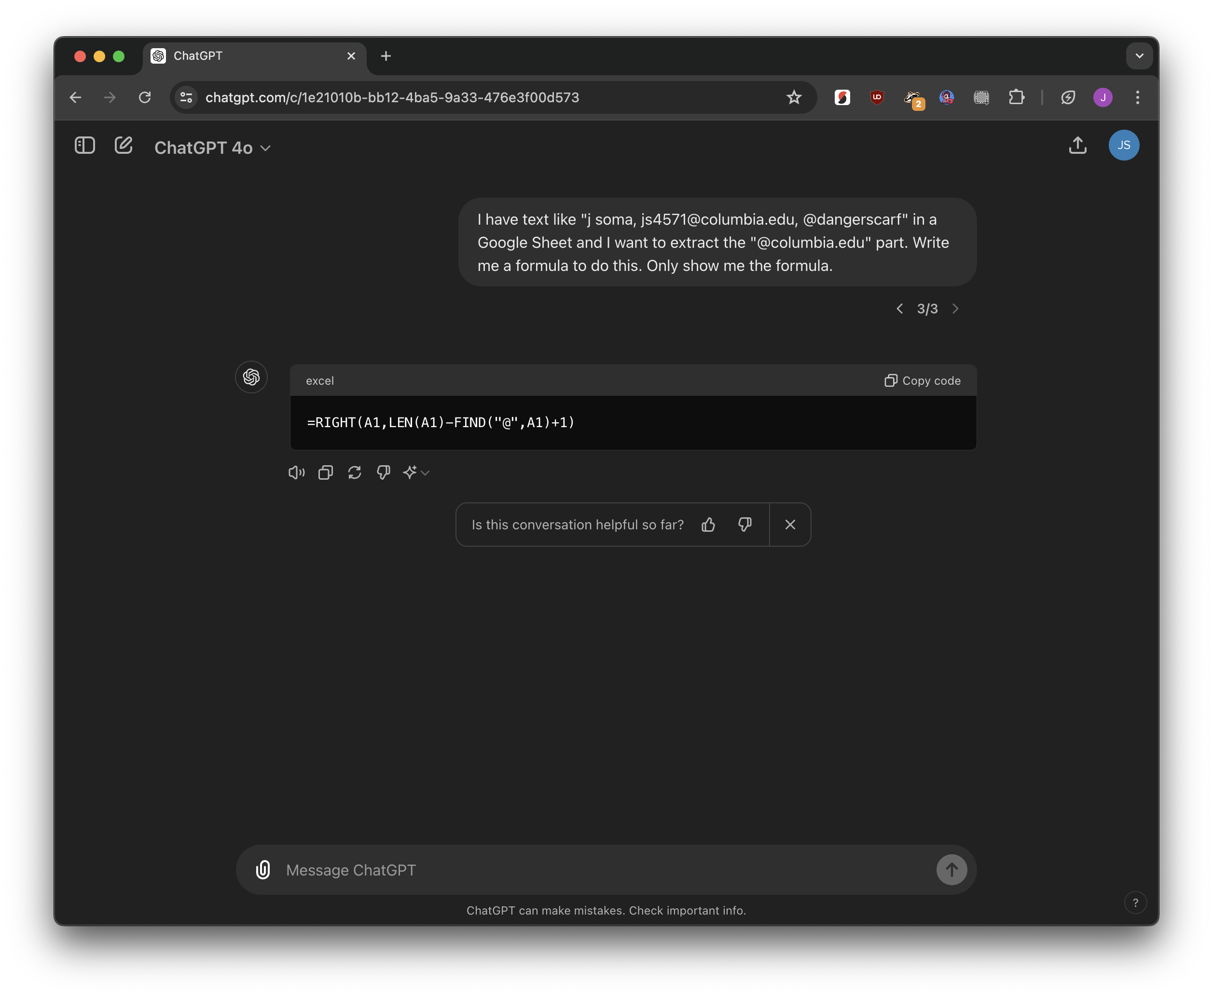
just ask!
then TEST IT

Slide 11

Feel free to reach out at 555-555-5555
take the final 12 letters
555-555-5555

Slide 12
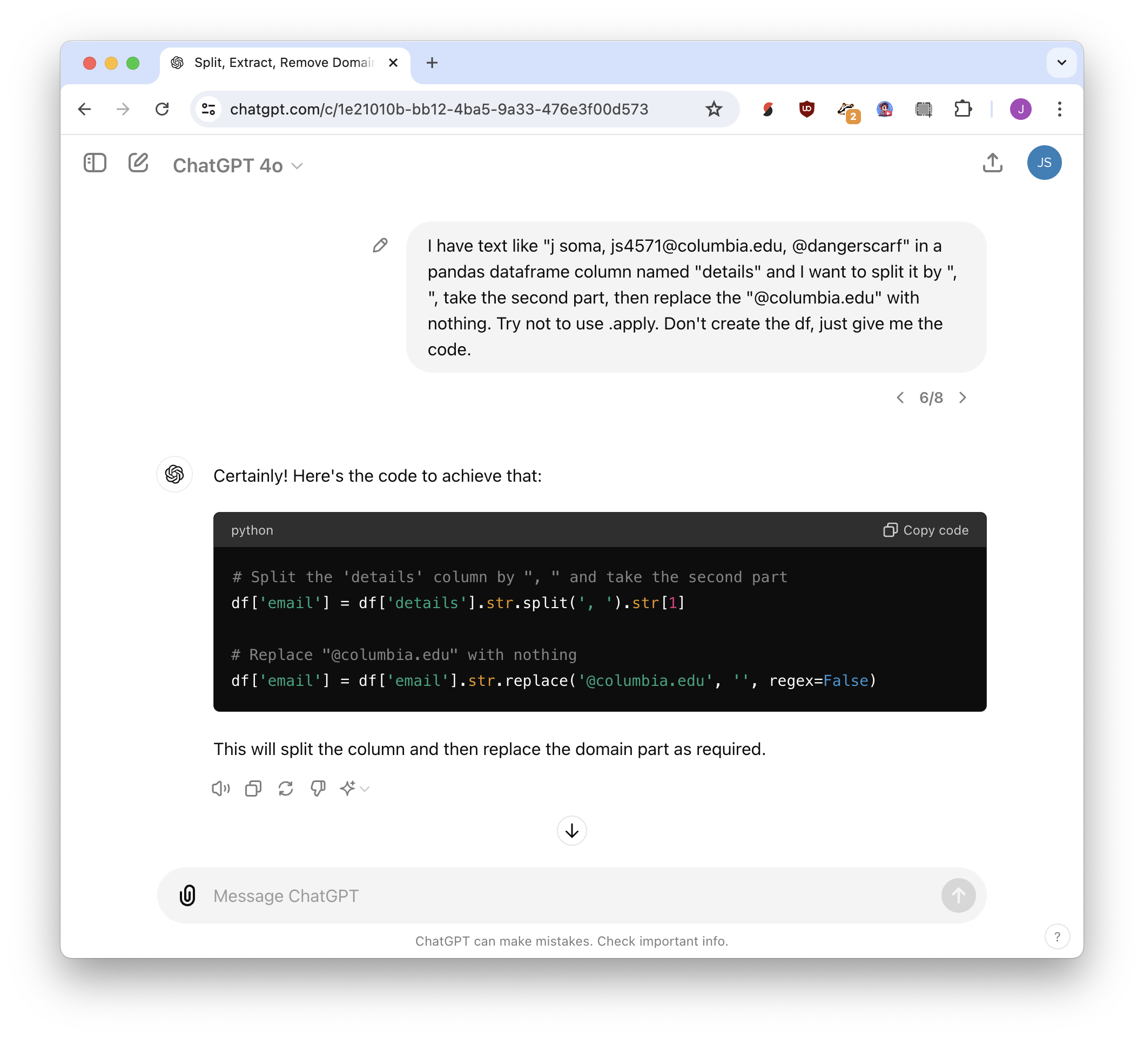
just ask!
then TEST IT

Slide 13
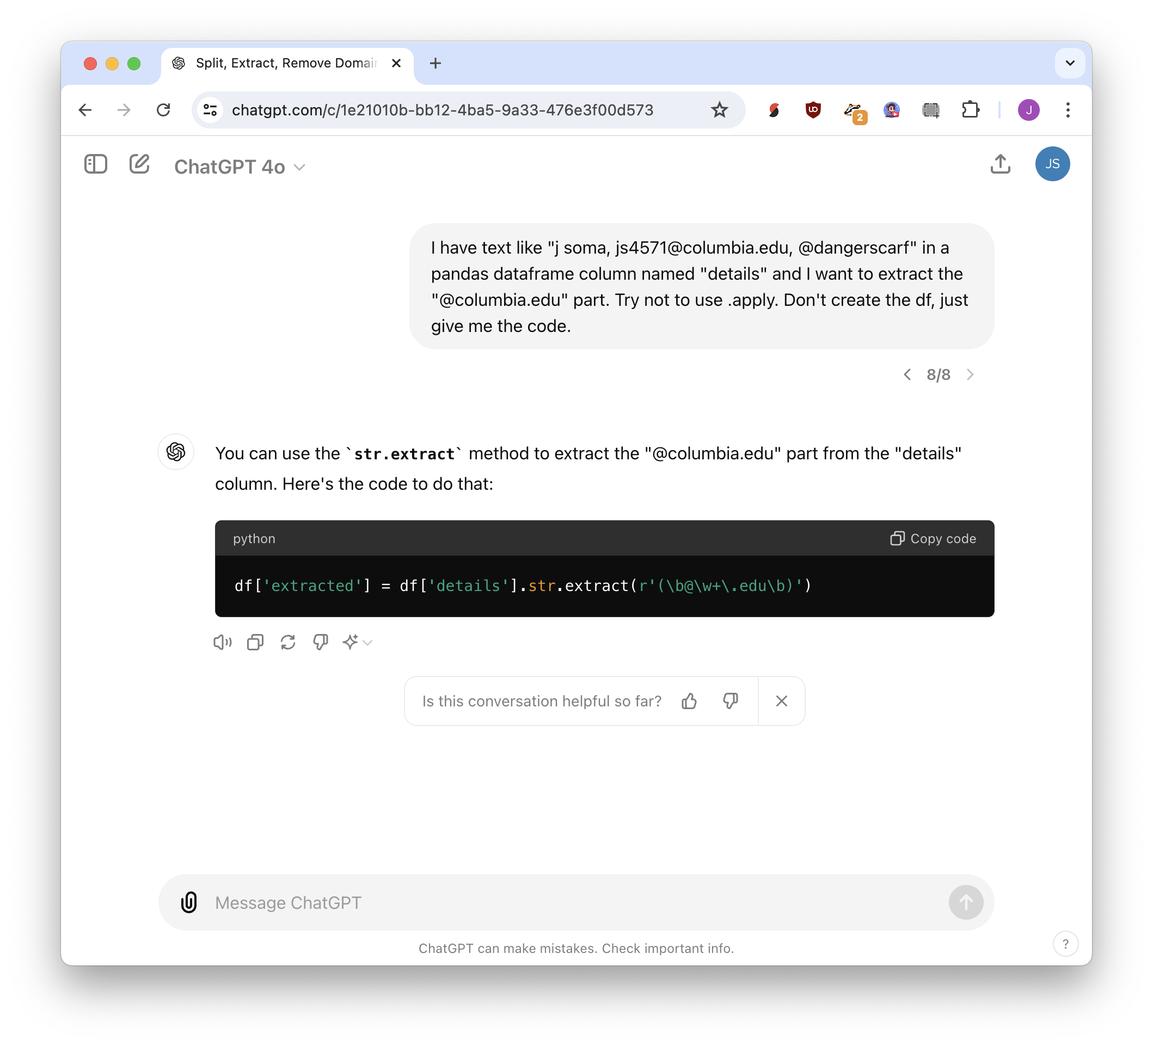
just ask!
then TEST IT

Slide 14
Regular expressions
Regular expressions
regex is the other other 1%

Slide 15


66 years old
hug what we want
(capture group)
(66) years old
match anything
(.*) years old

Slide 16
I am 66 years old
hug what we want
I am (66) years old
match anything
I am (.*) years old

Slide 17




Contact me at 555-555-5555
hug what we want
Contact me at (.*)
but maybe not!
Contact me at 555-555-5555 or js4571@columbia.edu
Contact me at (\d\d\d-\d\d\d-\d\d\d\d)
just numbers

Slide 18

Contact me at 555-555-5555
maybe we don’t
need an anchor?
(\d\d\d-\d\d\d-\d\d\d\d)

Slide 19
Contact me at 5555555555
maybe hyphens are optional?
(\d\d\d-?\d\d\d-?\d\d\d\d)

Slide 20
Contact me at 555+555+5555
any character is fine!
(and also optional)
(\d\d\d.?\d\d\d.?\d\d\d\d)

Slide 21
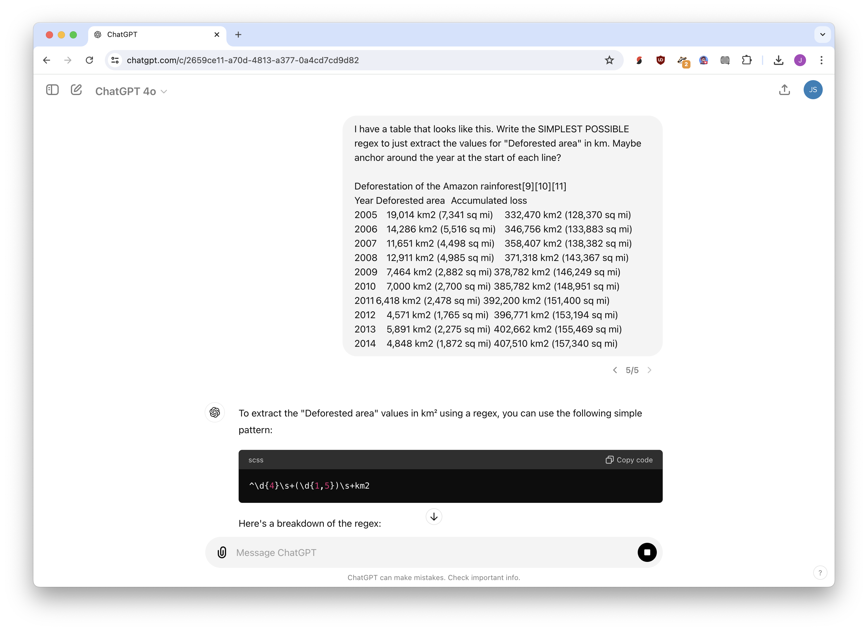
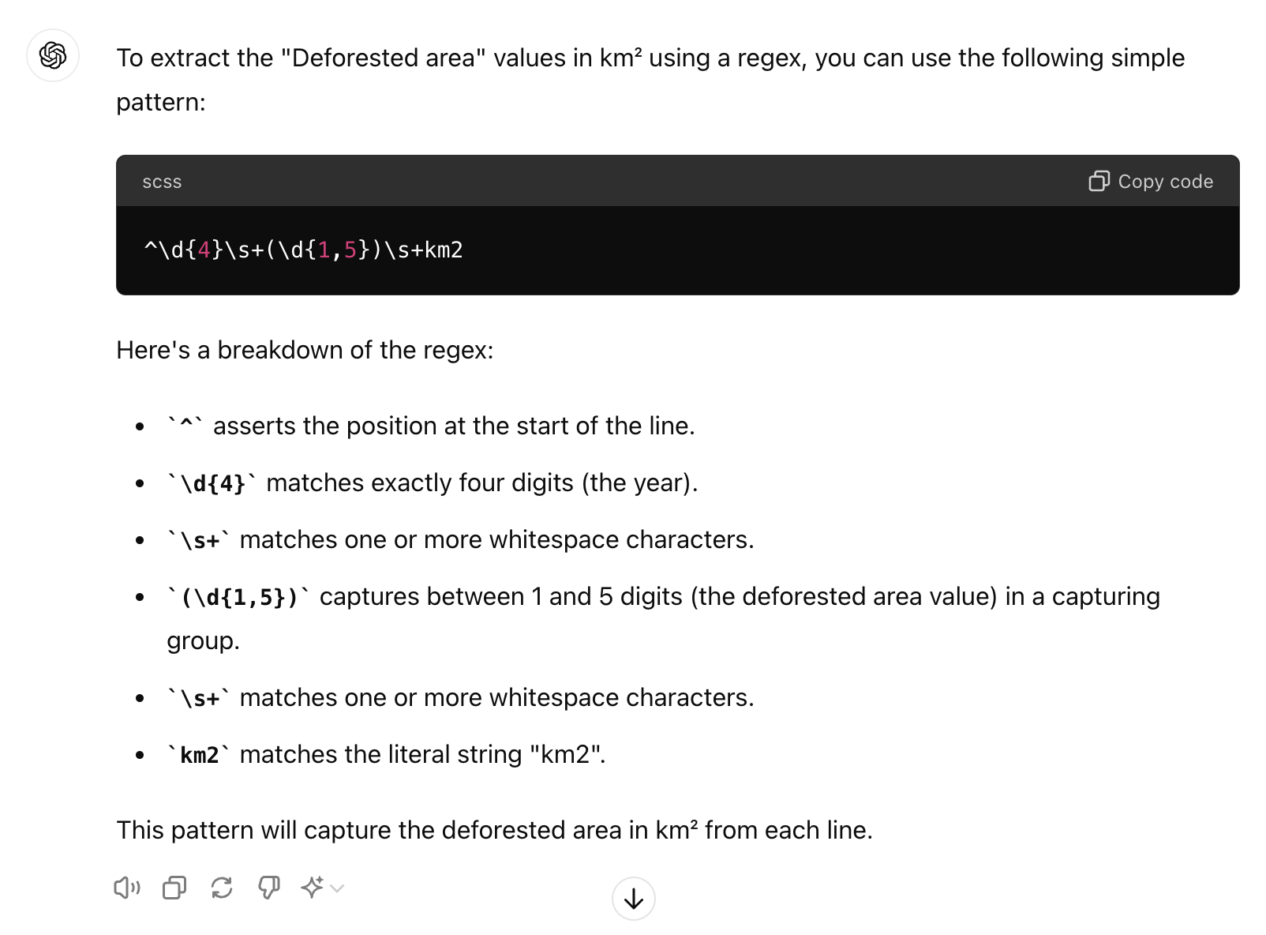
just ask!
then TEST IT

Slide 22
Addresses and maps

Slide 23
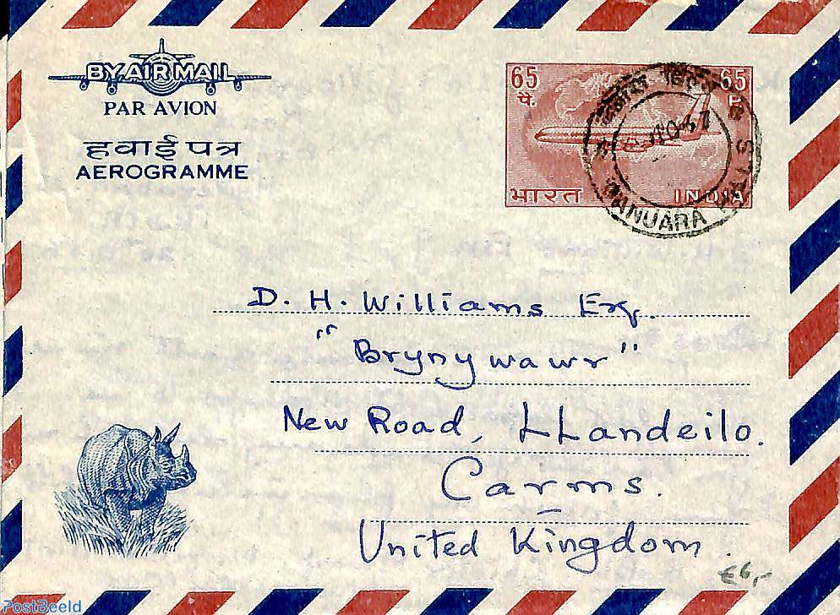

Geocoding
Latitude/Longitude
Plain address
Reverse geocoding

Slide 24
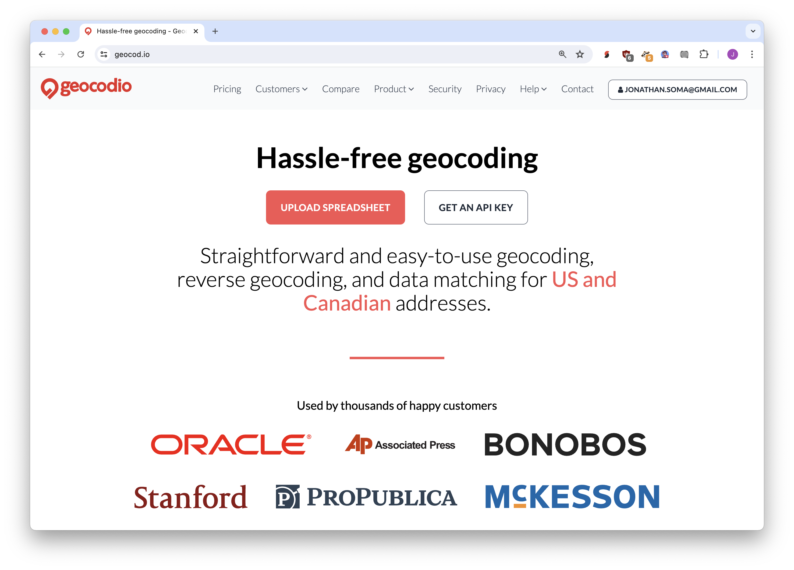
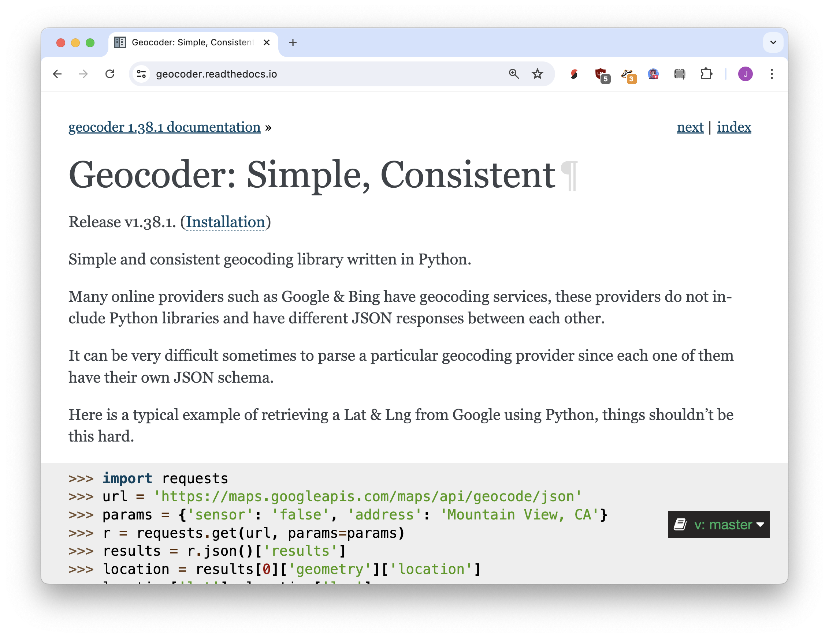
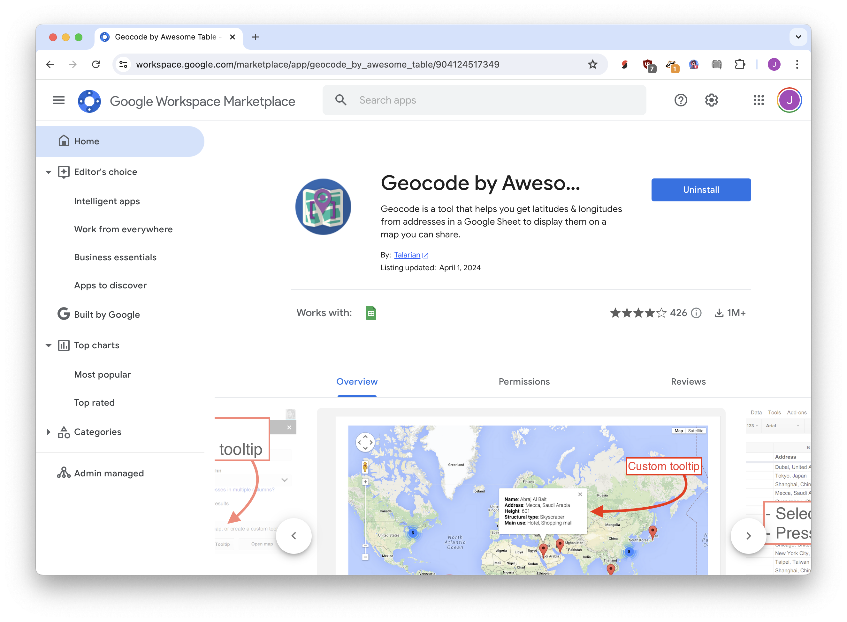
drag and drop: geocod.io
python: geocoder
sheets: geocode by awesome table

Slide 25
Generating structured data with the awful power of LLMs

Slide 26
FROM: Mulberry Peppertown (mulbs@example.com)
When I pick up the cans of beans they are all so light! At first I thought they were empty, but it turns out they are just futuristic beans that are not heavy like the old style beans I was used to. It is incredible.
Mulberry Peppertown
name
mulbs@example.com
email
beans
food item

Slide 27
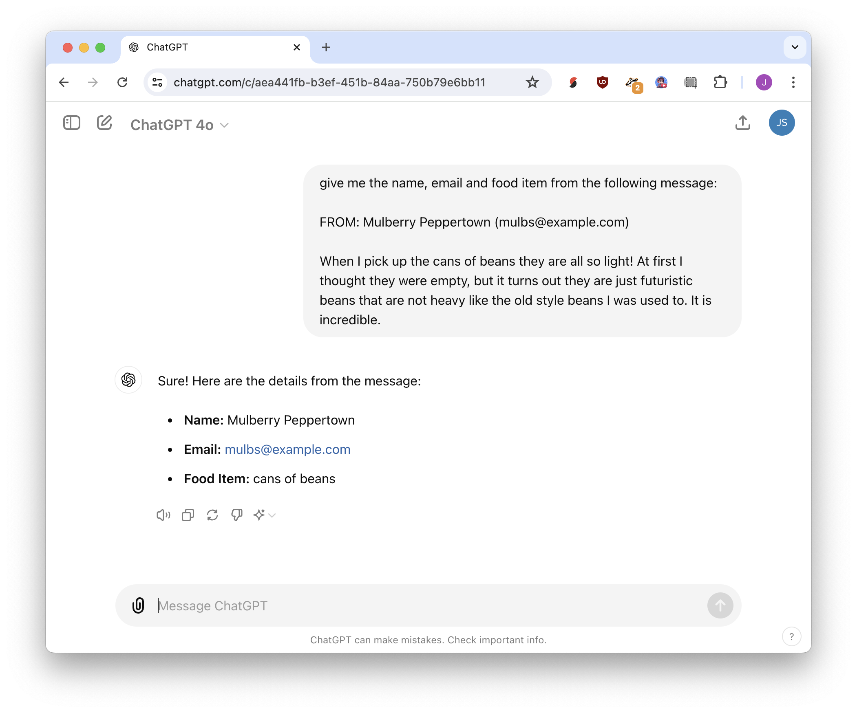

Slide 28
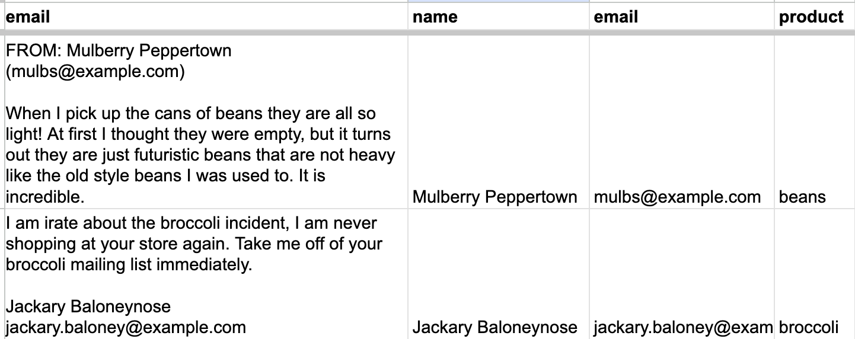
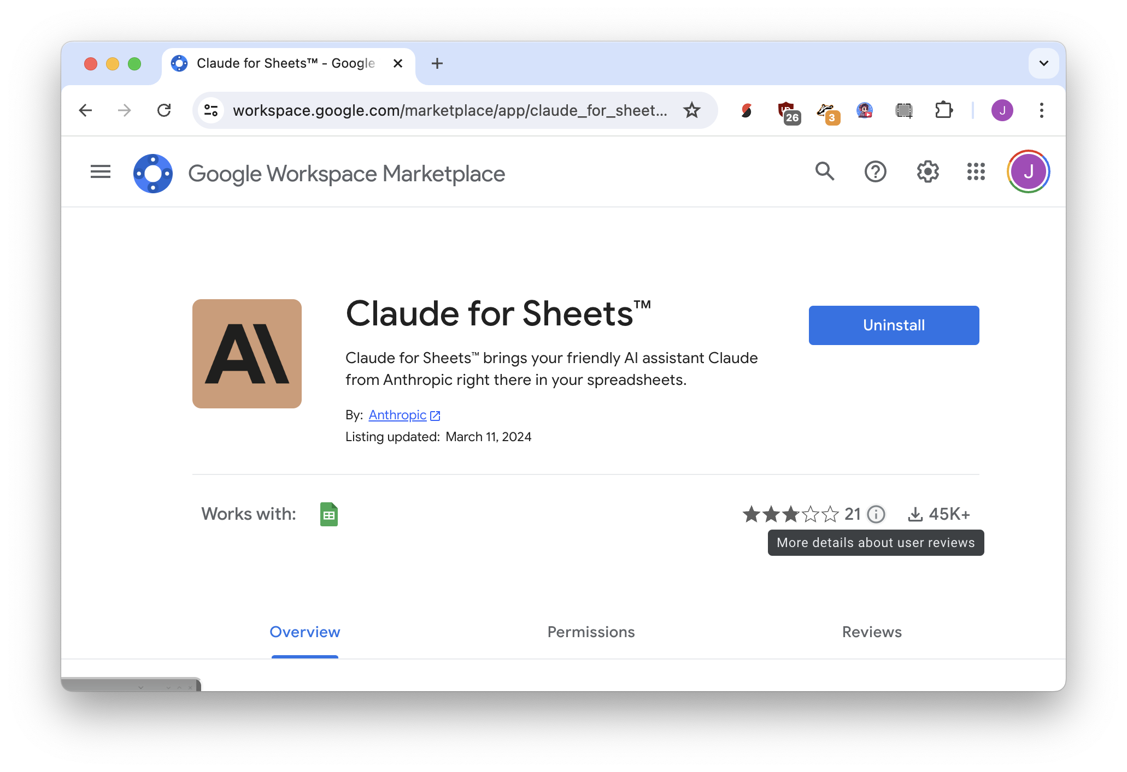
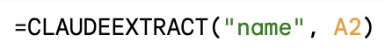
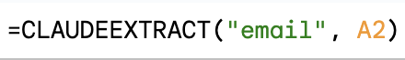
Sheets: Claude for Sheets

Slide 29
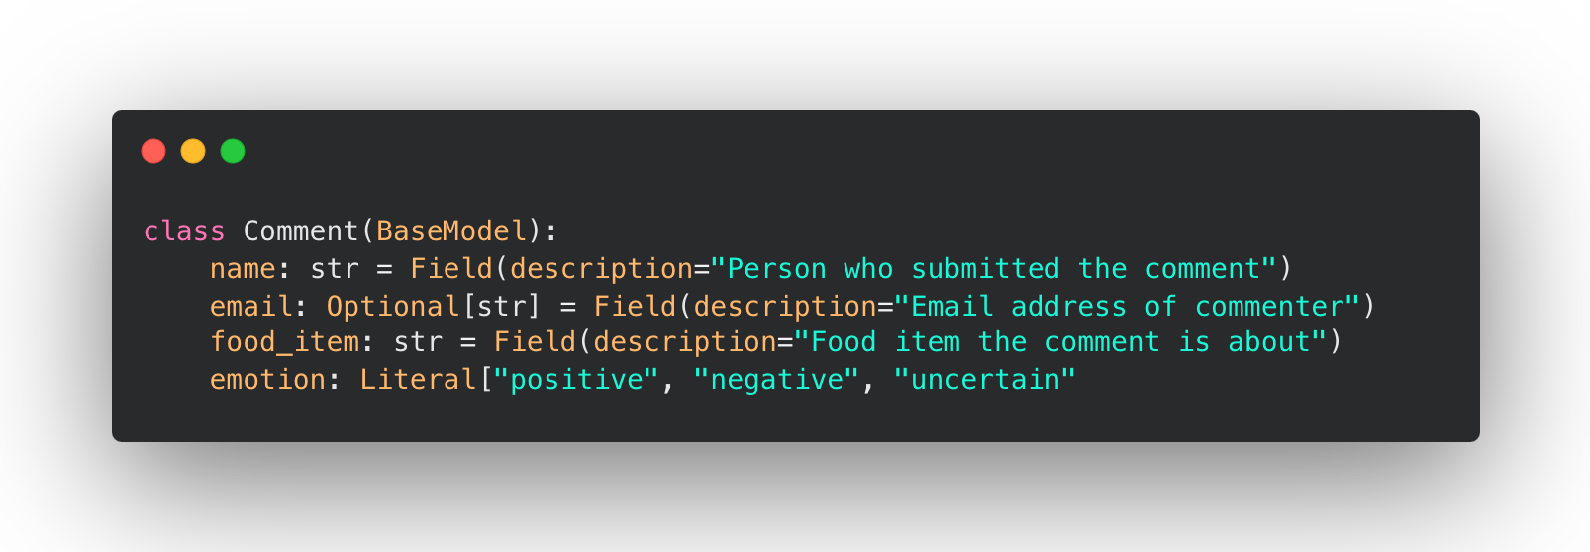
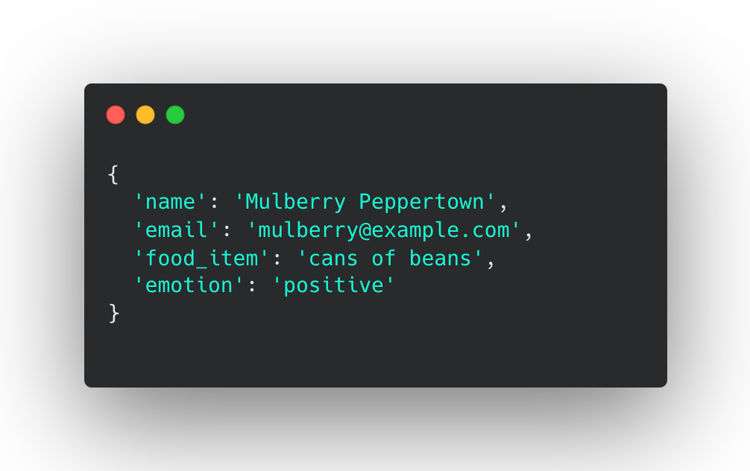
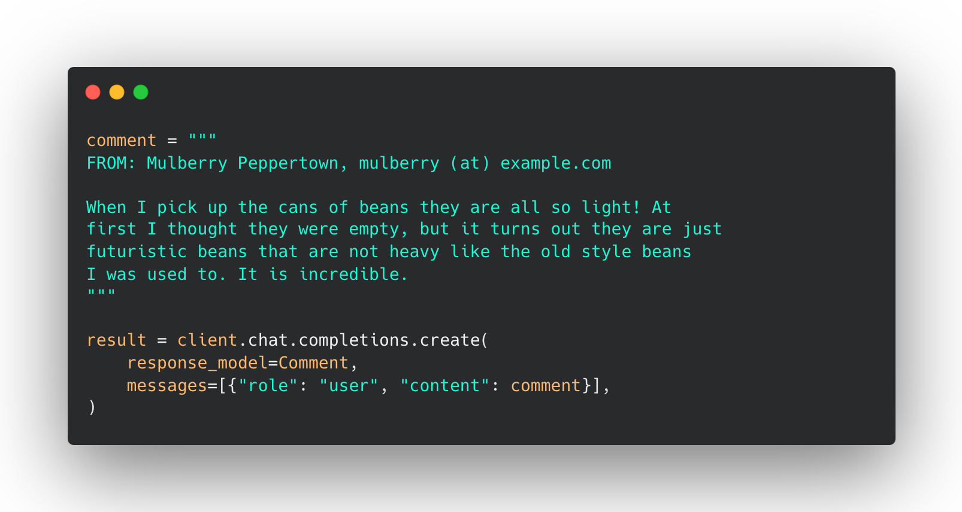
Python: Instructor

Slide 30
now let’s do a little more pandas
it will be… fun?

Slide 31
Structured data
Visit https://bit.ly/ds-dojo-2024 for materials
Pandas, CSVs, Excel and APIs

Slide 32
APIs
Visit https://bit.ly/ds-dojo-2024 for materials
structured data from the internet

Slide 33
Does anyone have a favorite pokemon?
This is an important question

Slide 34



me

Slide 35
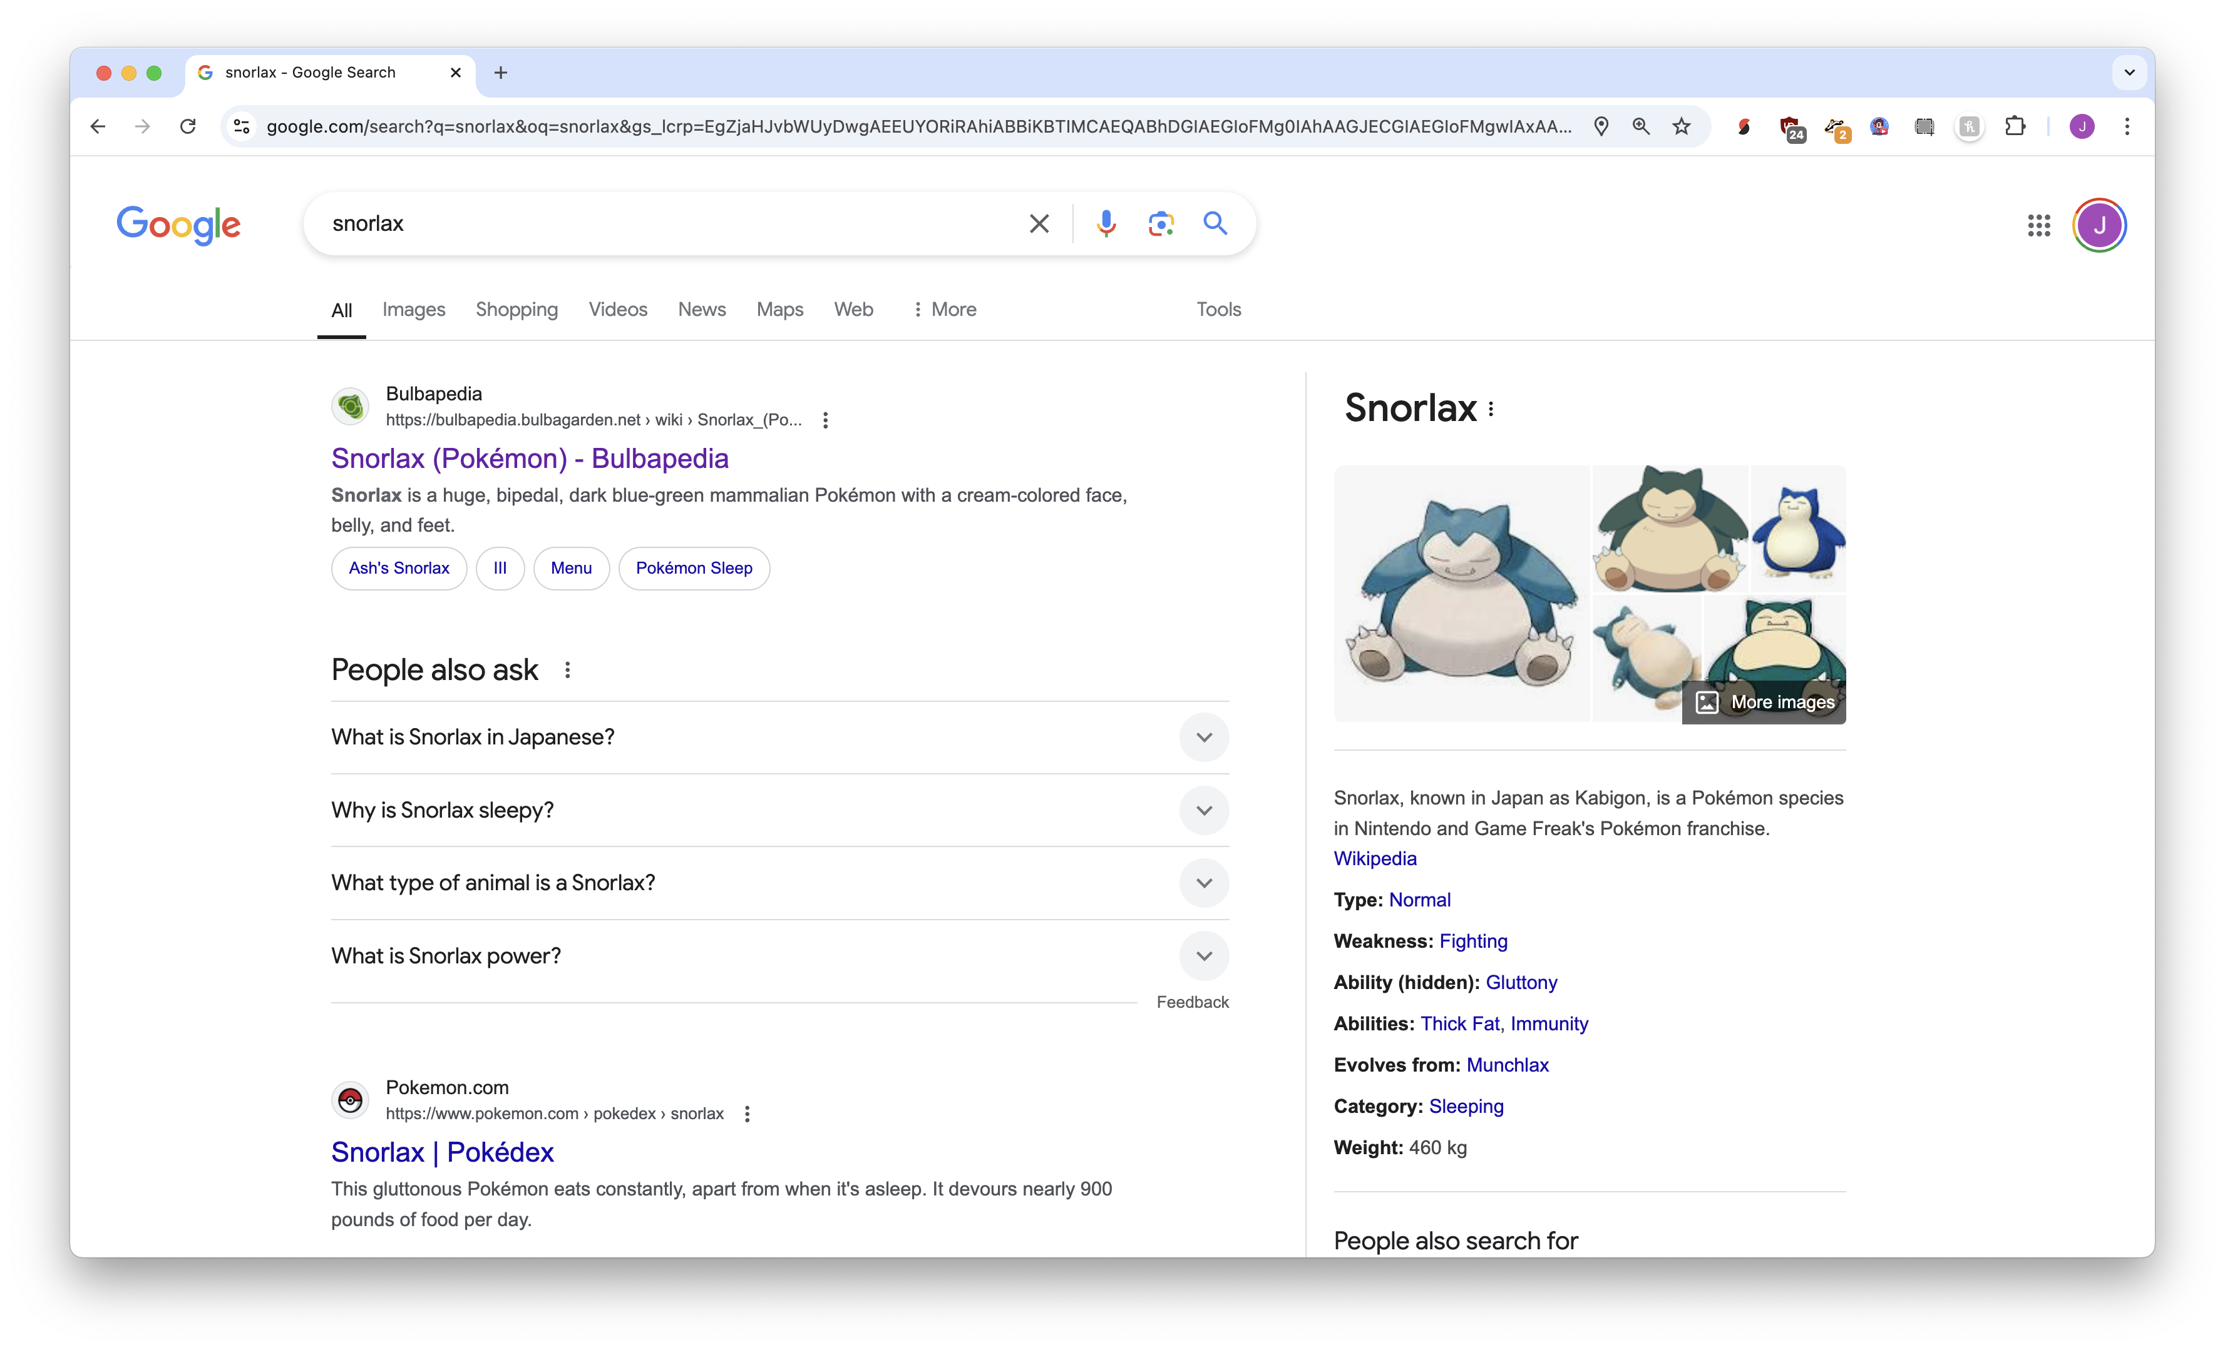

Slide 36
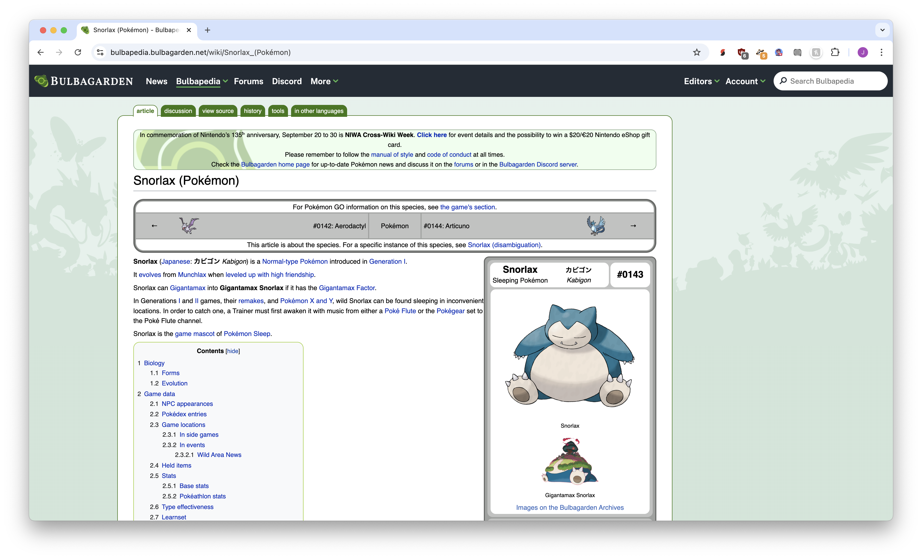

Slide 37
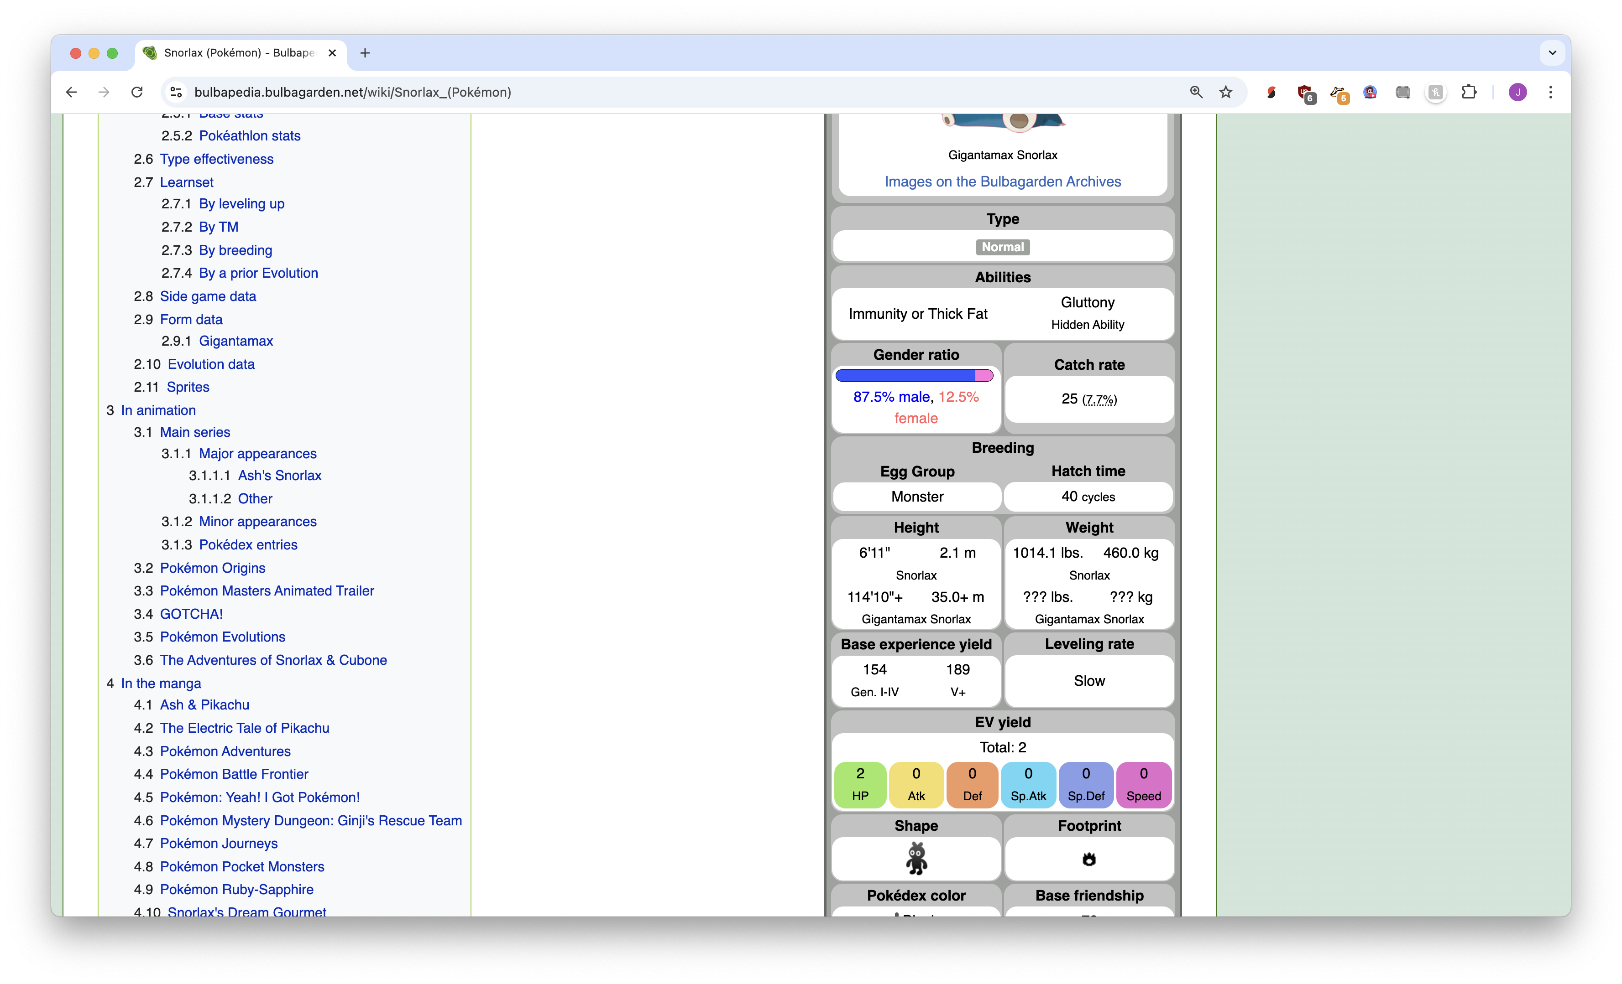

Slide 38
Structured vs unstructured data
Easy for computers to understand and process
CSV files + XML, JSON, Excel, etc etc etc
Easy for humans to understand and process
Websites, books, articles, etc etc etc

Slide 39
APIs
Application Programming Interface

Slide 40
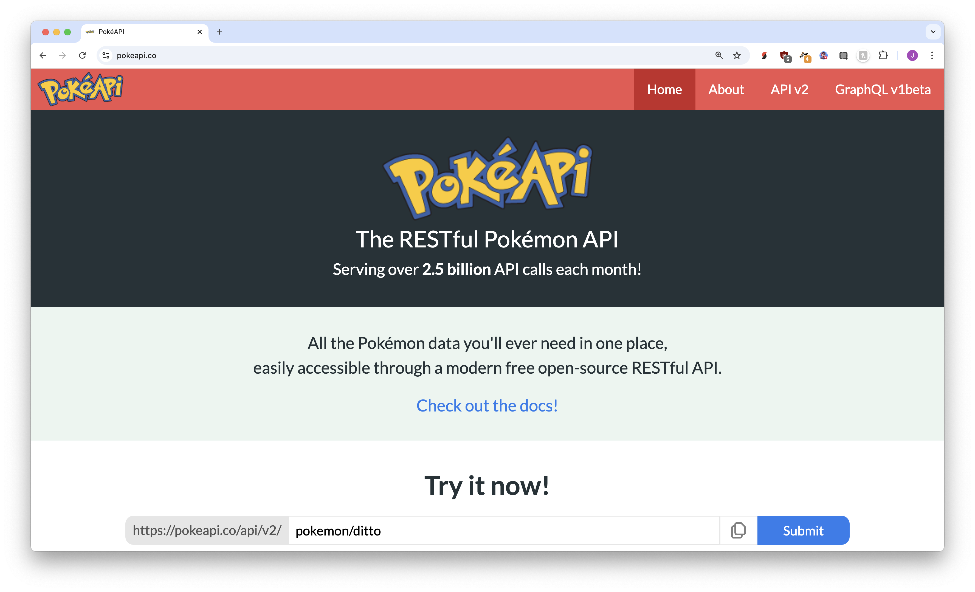

APIs
https://pokeapi.co
Structured data

Slide 41
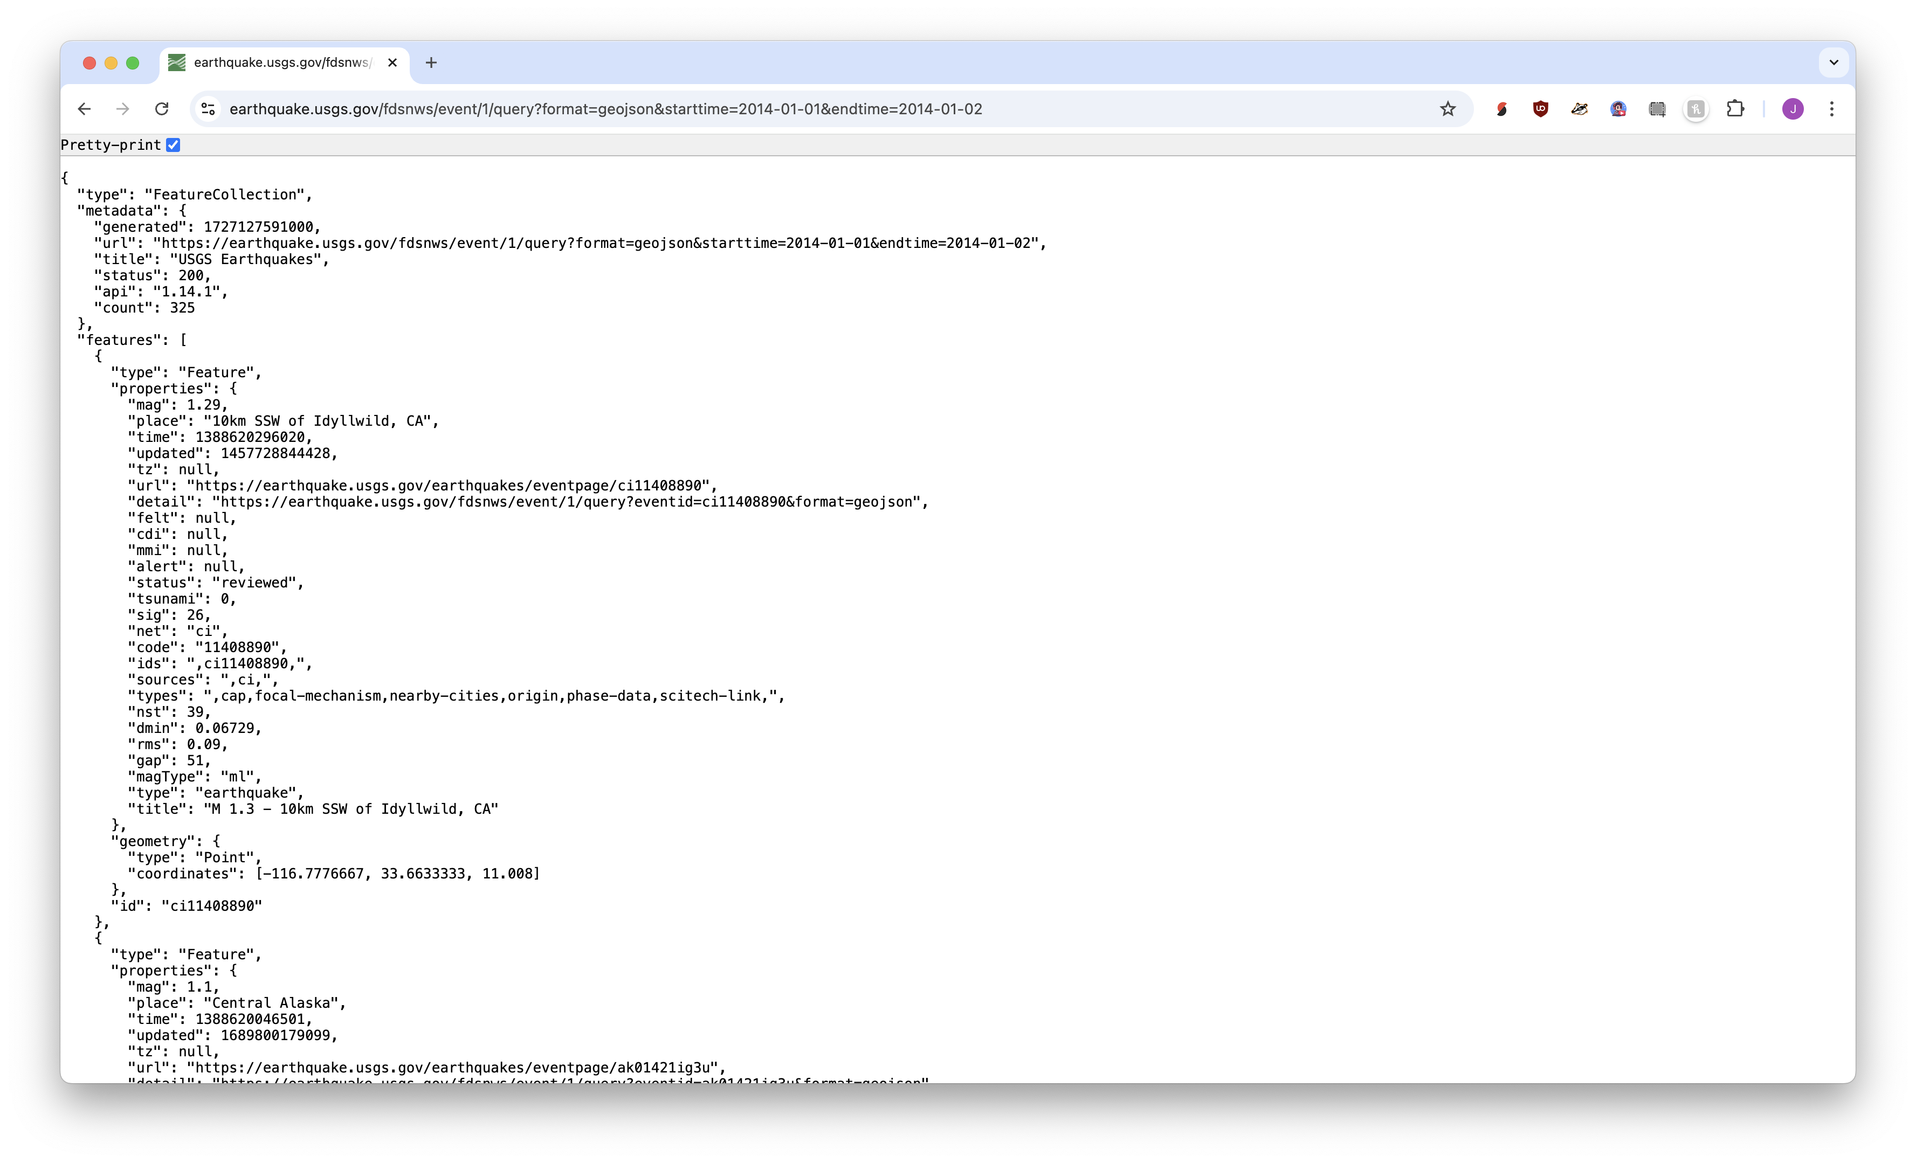

Slide 42
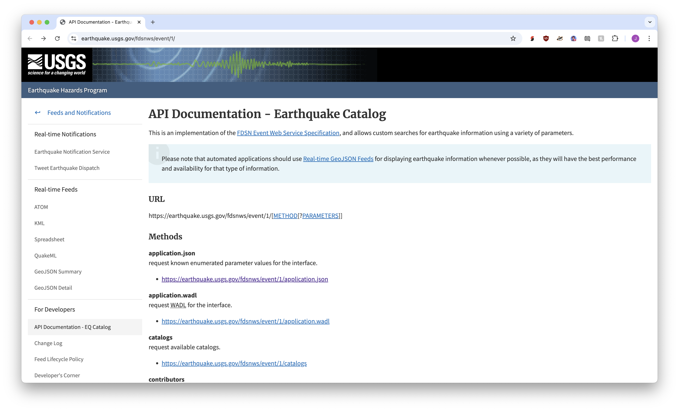
https://earthquake.usgs.gov/fdsnws/event/1/

Slide 43
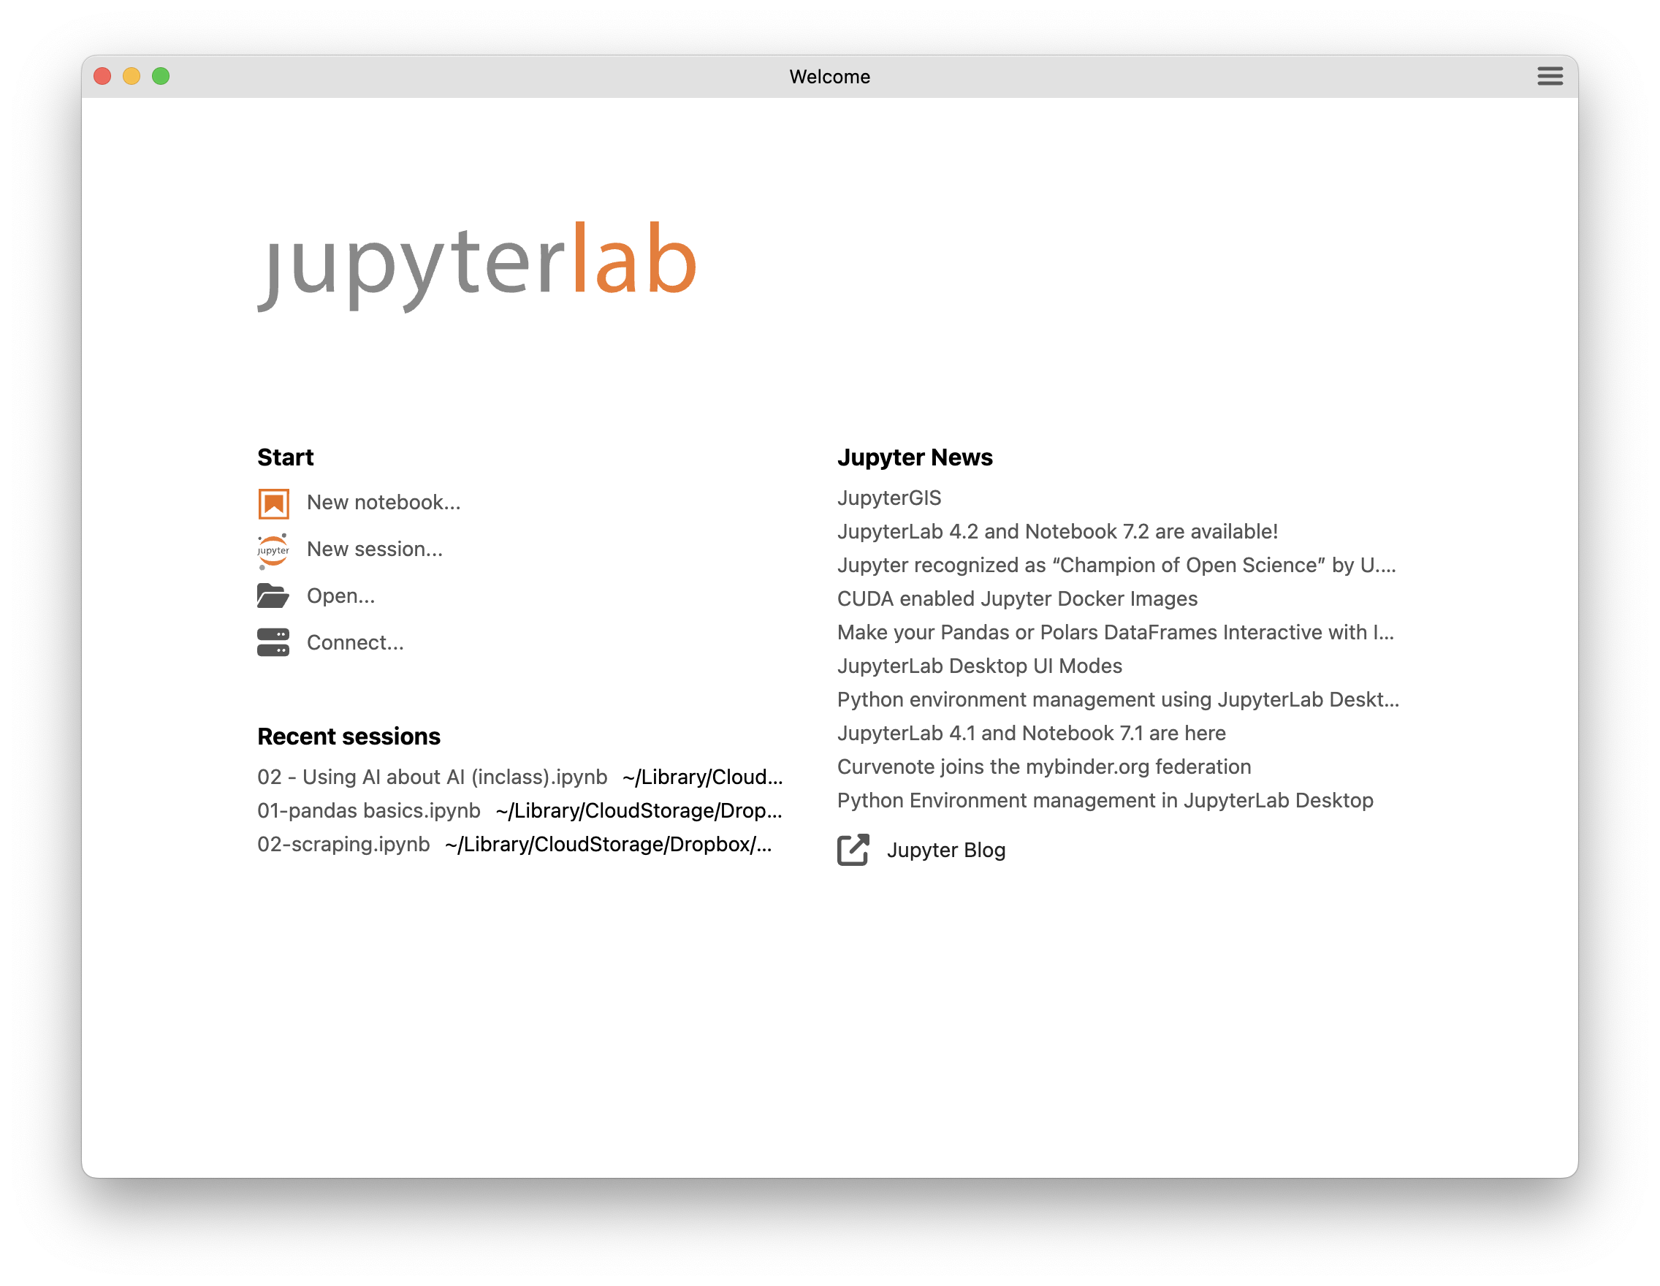
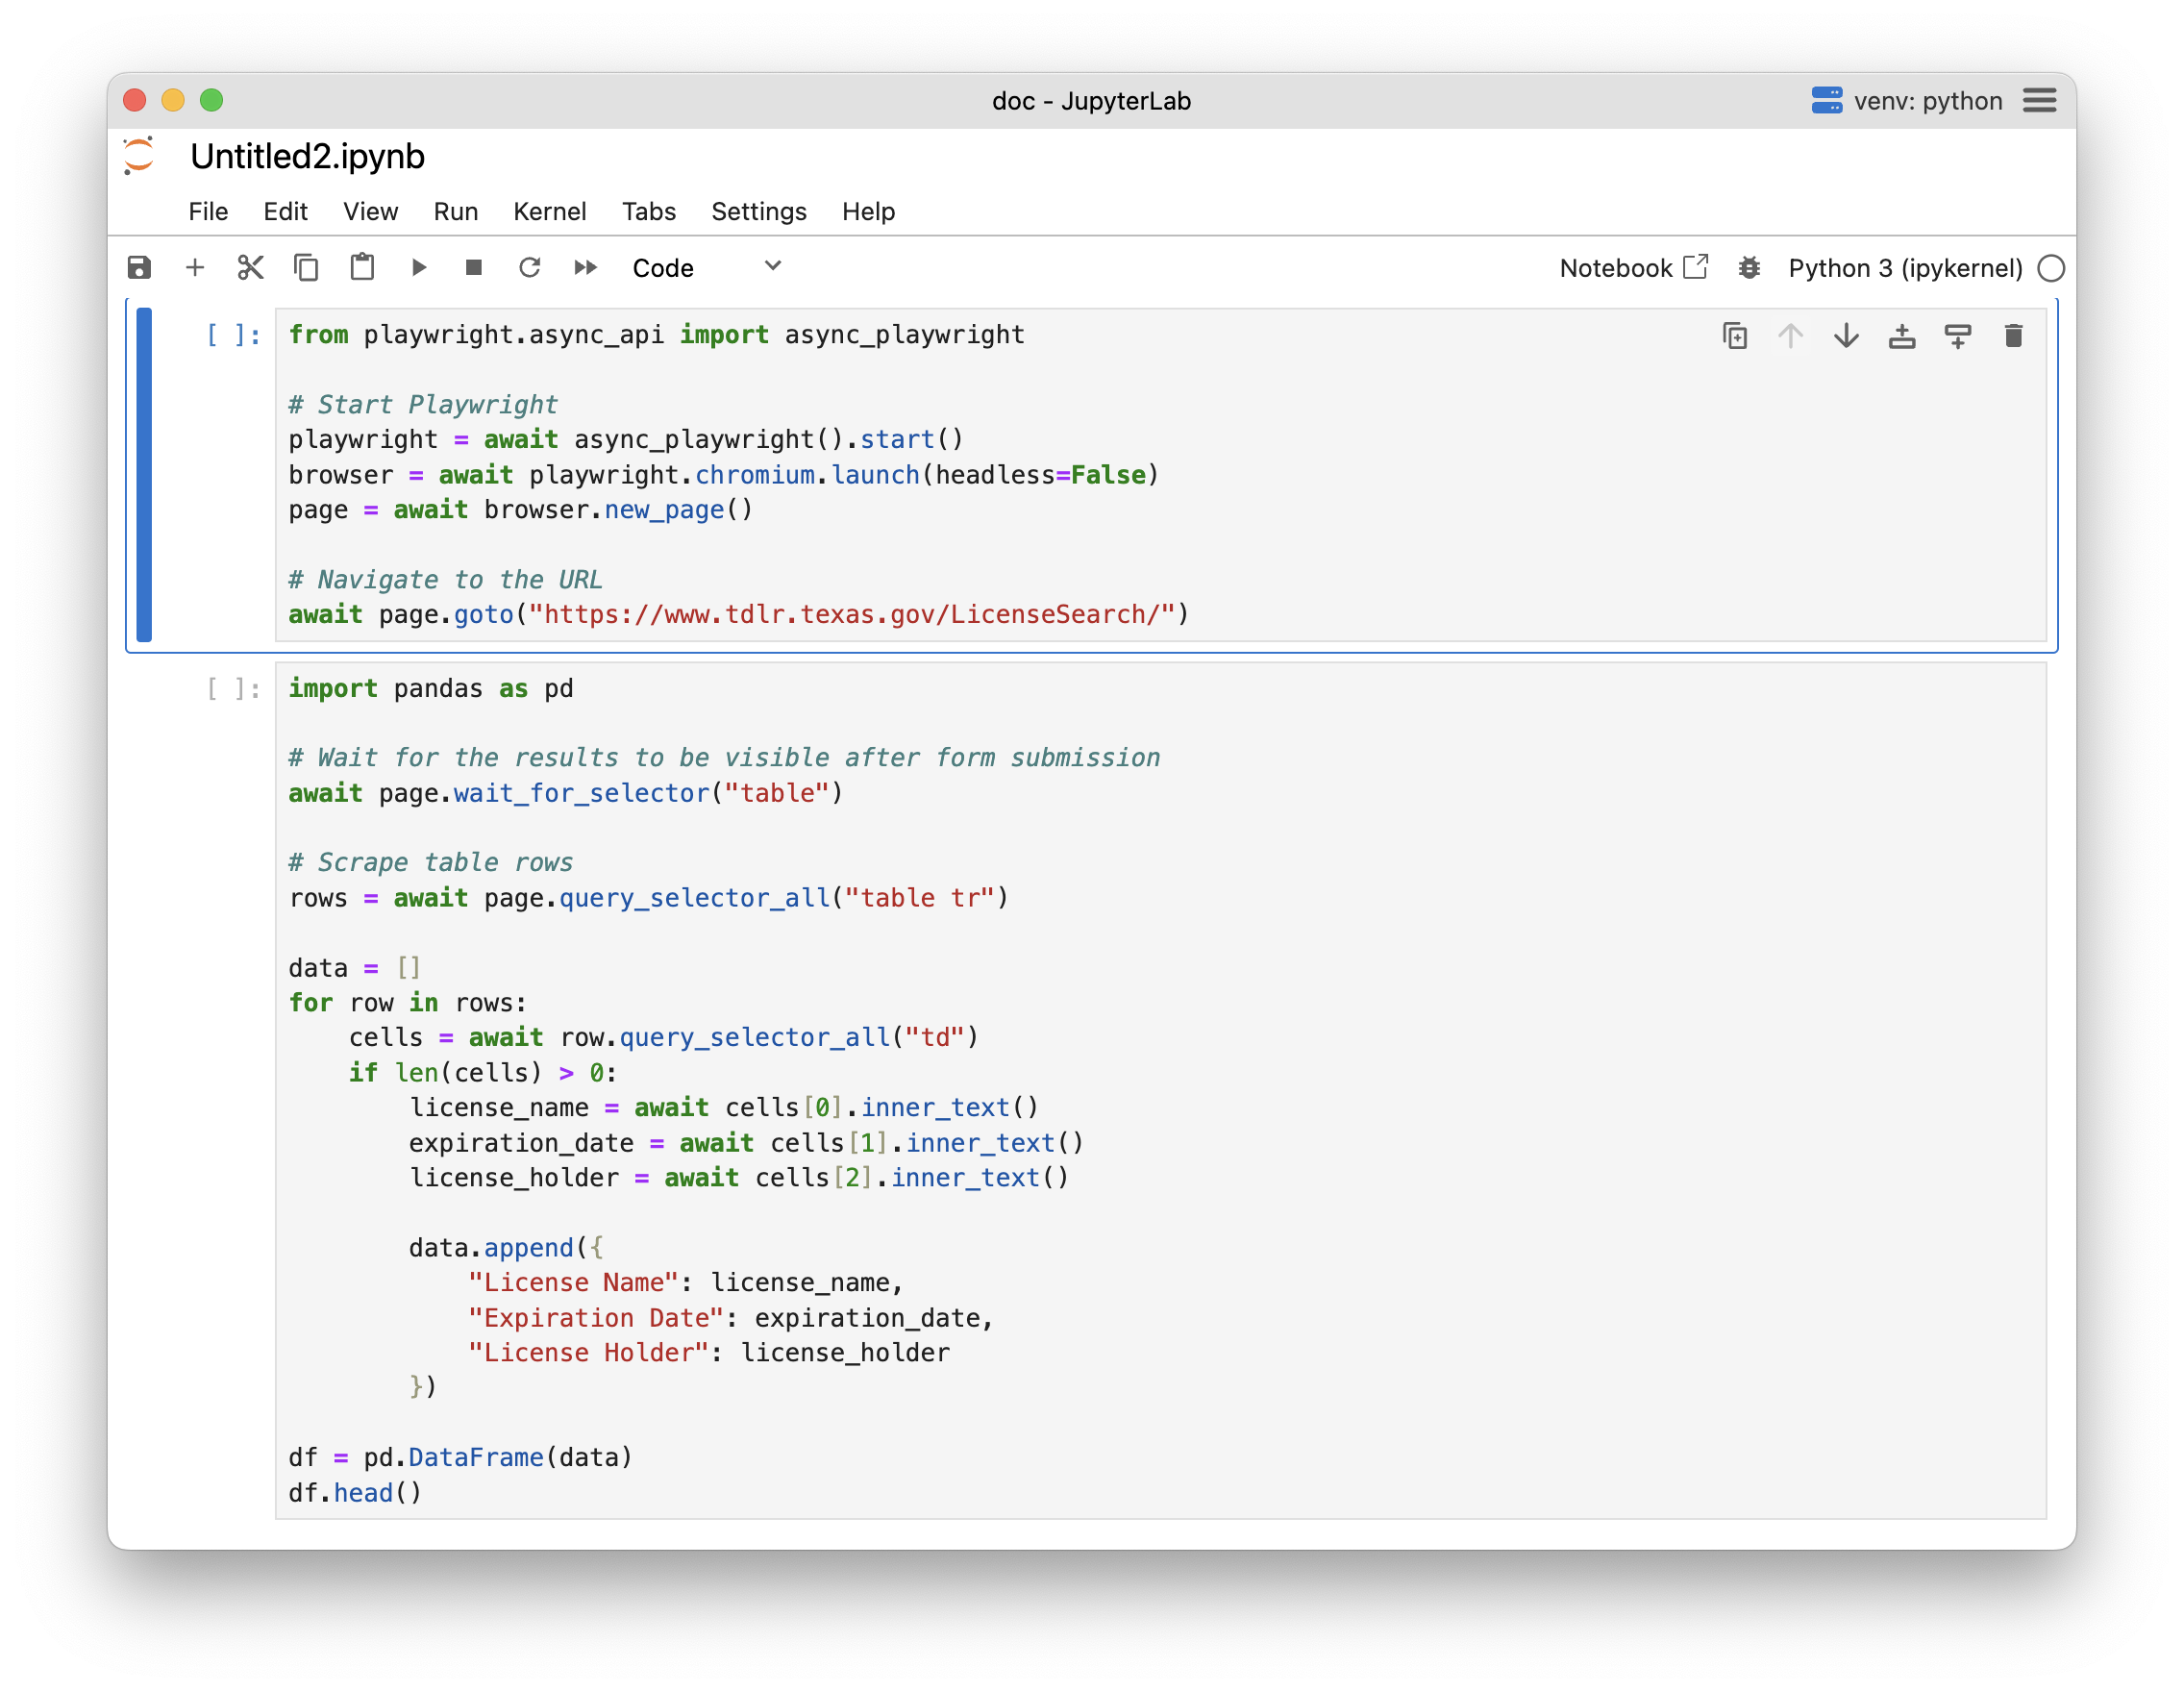
Open JupyterLab
Open 01-Earthquakes.ipynb

Slide 44
APIs
Visit https://bit.ly/ds-dojo-2024 for materials
structured data from the internet

